Slide 1
CSE- 105
Structure Programming
CONTROL STRUCTURE

Slide 2
Algorithm Development
So far, we considered very simple programs (read, compute, print)
Top-down Design
  Start from the big picture
  Use a process called divide-and-conquer
  Keep dividing the problem until steps are detailed enough to convert to a program
  Refinement with Pseudo-code (English like statements) and Flowchart (diagram, graph)
  For Example : Area calculation problem of a circle… … …

Slide 3
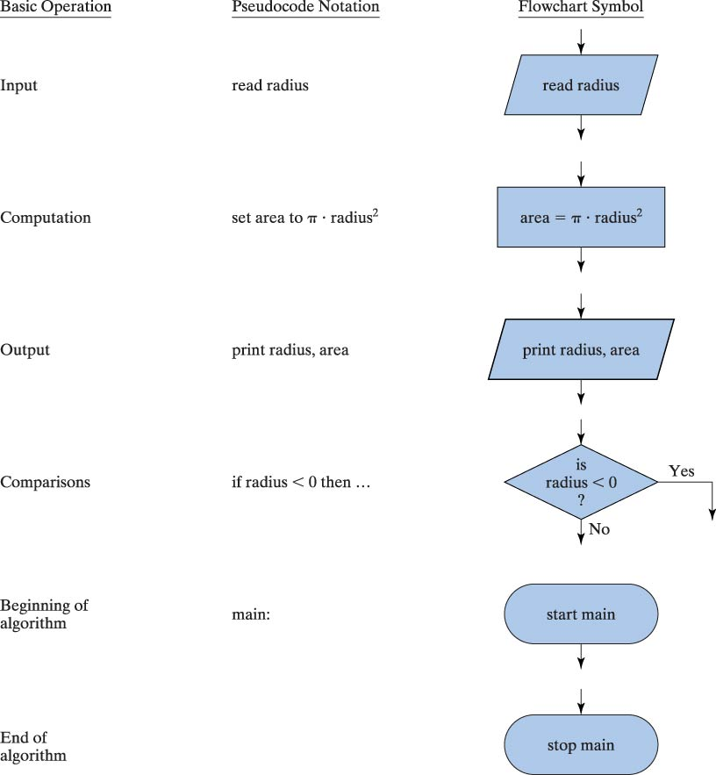
Pseudo-code Notation and Flowchart Symbols

Slide 4
Structured Programming
Use simple control structures to organize the solution to a problem
Sequence
Selection
Repetition
no
yes
no
yes

Slide 5
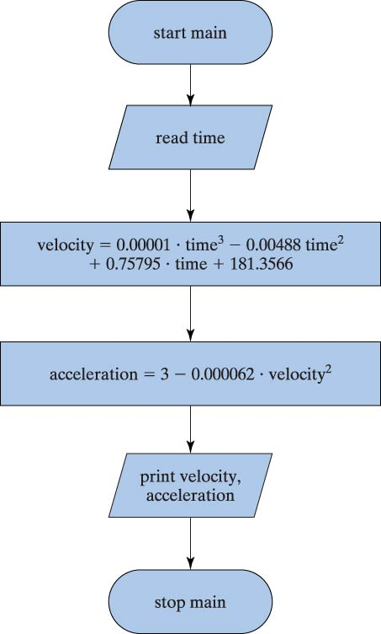
Sequence
Write a program that takes time “T” as input and calculate velocity
V=0.00001.T³-0.00488T²+ 0.75795.T + 181.3566
and acceleration
A =3-0.000062.V²

Slide 6
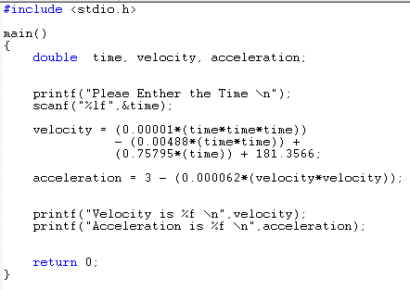
Sequence

Slide 7
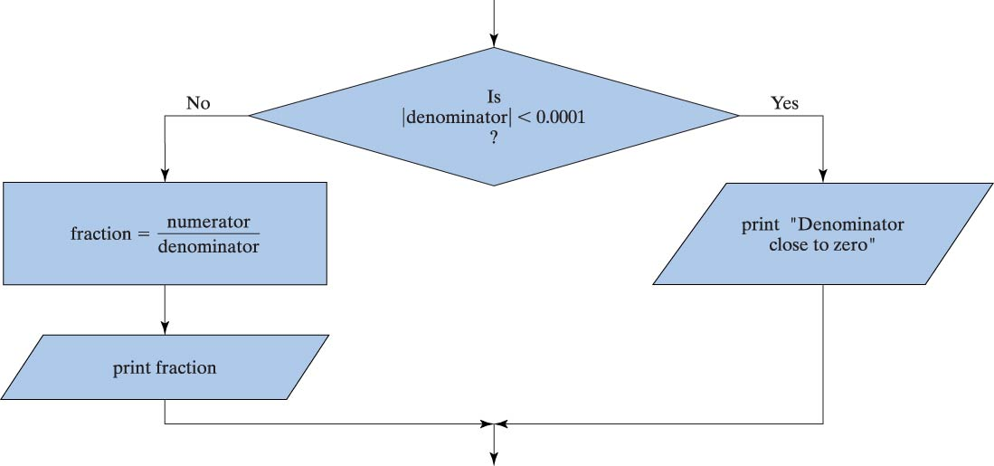
Selection
Notes:
#include <stdio.h>
main()
{
double denominator, fraction, numerator=10.0;
printf("Pleae Enther the Denominator \n");
scanf("%lf",&denominator);
if (denominator<0.0001)
printf("Denominator close to Zero \n");
else
printf("Fraction is %f \n", fraction = numerator/denominator);
return 0;
}

Slide 8
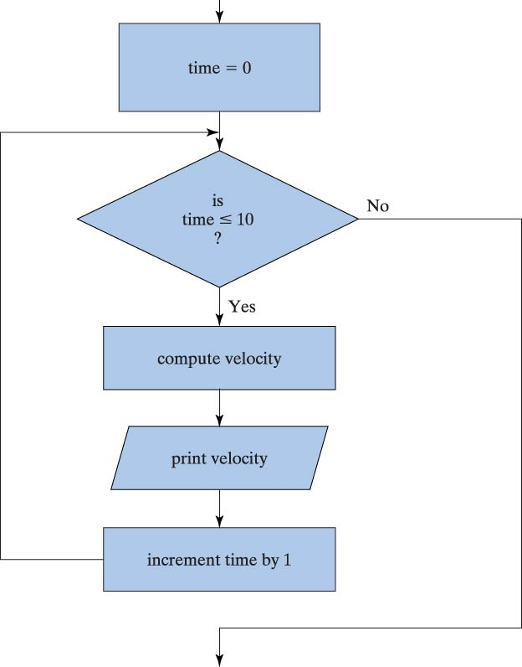
Repetition

Slide 9
Extras
Evaluation of alternative solution
  A problem can be solved in many different ways
  Which is the best (e.g, faster, less memory req)
Error condition
  Do not trust user! Check the data. A=b/c;
  Be clear about specifications
Generation of Test Data
  Test each of the error conditions
  Program validation and verification
  Program walkthrough

Slide 10
Conditional Expressions
Selection and repetition structures use conditions, so we will first discuss them
A condition is an expression (e.g., a > b) that can be evaluated to be
  TRUE (any value > 0) or
  FALSE (value of 0)
Conditional Expression is composed of expressions combined with relational and/or logical operators

Slide 11
Relational Operators
== equality (x == 3)
!= non equality (y != 0)
< less than (x < y)
> greater than (y > 10)
<= less than equal to (x <= 0)
>= greater than equal to (x >= y)
!!! a==b vs. a=b !!!

Slide 12
Examples
A < B
D= b > c;
If (D)
A=b+c;
Mixing with arithmetic op
  X+Y >= K/3
4
2
4
3
4
2
1
10
A
B
C
b
c
X
Y
K

Slide 13
Logical Operators
! not !(x==0)
&& and (x>=0) && (x<=10)
|| or (x>0) || (x<0)
A | B | A && B | A || B | !A | !B
False | False | False | False | True | True
False | True | False | True | True | False
True | False | False | True | False | True
True | True | True | True | False | False

Slide 14
Examples
A<B && C>=5
A+B * 2 < 5 && 4>=A/2 || T-2 < 10
A < B < C ????
A<B<C is not the same as
  (A<B) && (B<C)

Slide 15
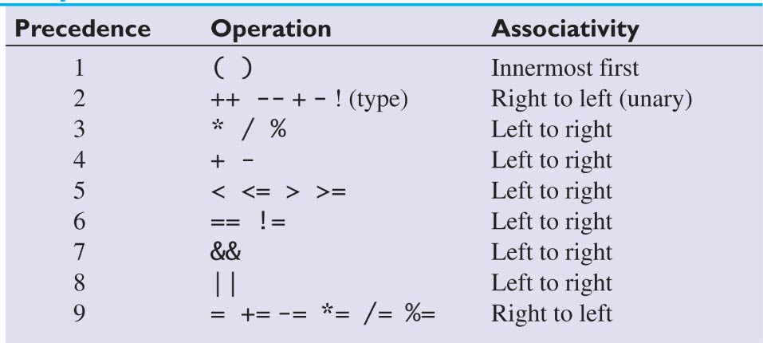
Precedence for Arithmetic, Relational, and Logical Operators

Slide 16
Exercise
Assume that following variables are declared
  a = 5.5 b = 1.5 k = -3
Are the following true or false
    a < 10.0 + k
    a + b >= 6.5
    k != a-b
    !(a == 3*b)
    a<10 && a>5

Slide 17
Selection Statements
if
if else
switch

Slide 18
if statement
if(Boolean expression)
statement; /* single statement */
if(Boolean expression) {
/* more than one statement */
statement1;
…
statement n;
}

Slide 19
if statement - examples
    if (x > 0)
    k++;
    if(x > 0) {
    x = sqrt(x);
    k++;
    }
    if(x > 0) /* a common mistake */
    x = sqrt(x);
    k++;

Slide 20
if else statement
if(Boolean expression)
statement;
else
statement;
if(Boolean expression)
{
statement block
}
else
{
statement block
}

Slide 21
if else statement
What does the following program do?
Assume that x, y, temp are declared.
int x=10, y=20, temp;
if (x > y)
temp = x;
else
temp = y;
Split the statement into two separate if statements
if (x>y)
temp = x;
if (x<=y)
temp = y;

Slide 22
Exercise
Write an if-else statement to find both the maximum and minimum of two numbers.
Assume that x, y, min, max are declared.
  if (x>y) { Ex: x = 10, y = 5
  max = x; x = 3, y = 4
  min = y;} x = 6, y = 6
  else {
  max = y;
  min = x;}

Slide 23
nested if-else
if(x > y)
if(y < z)
k++;
else
m++;
else
j++;
if(x > y) {
if(y < z) {
k++;
} else {
m++;
}
} else {
j++;
}
F
x > y
T
y < z
T
j++
F
m++
k++

Slide 24
Erercise
What are the values of j, k and m, Where,
int x=9, y=7, z=2, k=0, m=0, j=0;
if(x > y)
if(y < z)
k++;
else
m++;
else
j++;
if(x > y) {
if(y < z) {
k++;
} else {
m++;
}
} else {
j++;
}
F
x > y
T
y < z
T
j++
F
m++
k++

Slide 25
Exercise
Given a score and the following grading scale write a program to find the corresponding grade.
  90-100 A
  80-89 B
  70-79 C
  60-69 D
  0-59 F

Slide 26
Solution-1
if ((score >= 90) && (score <=100))
grade = 'A';
else if ((score >= 80) && (score <= 89))
grade = 'B';
else if ((score >= 70) && (score <= 79))
grade = 'C';
else if ((score >= 60) && (score <= 69))
grade = ‘D';
else if ((score >= 0) && (score <= 59))
grade = ‘F';
else
printf("Invalide Score\n");

Slide 27
Solution-2
if ((score >= 0) && (score <= 100))
if (score >= 90)
grade = 'A';
else if (score >= 80)
grade = 'B';
else if (score >= 70)
grade = 'C';
else if (score >= 60)
grade = ‘D';
else
grade = ‘F';
else
printf("Invalid Score\n");

Slide 28
Exercise: Find the value of a
a > 0
T
int a = 750;
if (a>0)
if (a >= 1000)
a = 0;
else
if (a <500)
a = a* 2;
else
a = a* 10;
else
a = a+ 3;
a >= 1000
T
a = a+3
a < 500
T
a = 0
a = a*10
a = a*2

Slide 29
Exercise: Find the value of a
int a = 750;
if (a>0) {
if (a >= 1000) {
a = 0;
} else {
if (a <500) {
a = a*2;
} else {
a = a*10;
}
}
} else {
a = a+3;
}
a > 0
T
a >= 1000
T
a = a+3
a < 500
T
a = 0
a = a*10
a = a*2

Slide 30
Exercise: which task takes more time
Suppose we have two tasks A and B
  A takes Ah hours, Am minutes, and As seconds
  B takes Bh hours, Bm minutes, and Bs seconds
Write if-else statements to print out which task takes more time?

Slide 31
Indentation
int a = 750;
if (a>0)
if (a >= 1000)
a = 0;
else
if (a <500)
a *= 2;
else
a *= 10;
else
a += 3;
int a = 750;
if (a>0)
if (a >= 1000)
a = 0;
else
if (a <500)
a *= 2;
else
a *= 10;
else
a += 3;
Good
Not good

Slide 32
Exercise
What is the output of the following program
  int a = 5, b = 3;
  if (a>10)
  a = 50;
  b = 20;
  printf(" a = %d, b = %d\n",a, b);
  if (a>10) {
  a = 50;
  b = 20;
  }
  printf(" a = %d, b = %d\n",a, b);
  if (a>10)
  a = 50;
  b = 20;
  printf(" a = %d, b = %d\n",a, b);
  if (a>10) {
  a = 50;
  b = 20;
  }
  printf(" a = %d, b = %d\n",a, b);

Slide 33
More selection examples

Slide 34
Max, Min, Median
Write a program that reads 3 integer numbers a, b and c from user and computes minimum, median and maximum of the numbers.
Example:
  a = 2, b = 5, c = 3
    minimum = 2, maximum = 5, median = 3
  a = 2, b = 2, c = 3
    minimum = 2, maximum = 3, median = 2

Slide 35
Region in a plane
Write a program that reads a point
(x, y) from user and prints its region
Region 1
For example
Enter x, y: 3 -1
This point is in Region 4
Enter x, y: -1 -5
This point is in region 3
Region 2
Region 3
Region 4

Slide 36
Write if-else statement
score > 60
T
You fail
You pass
age > 18
T
age > 18
T
Very bad
Excellent
job
Good job
Don’t worry
Good luck next time

Slide 37
if (score > 60) {
printf(“You Pass\n”);
if (age > 18) {
printf(“Good job \n”);
} else {
printf(“Excellent job\n”);
}
} else {
printf(“You Fail\n”);
if (age > 18) {
printf(“ Very bad \n”);
} else {
printf(“ Don’t worry \n”);
}
printf(“ Good luck next time \n”);
}

Slide 38
get b, c from user
a = b + c
F
a <= 10 and b-c > 6
T
Print “RIGHT”, a, b, c
b= 5 + c * 2
c != b
T
F
Print “LEFT-RIGHT”, a, b, c
c= 5 + c * 2
F
a*b<=12
T
Print “RIGHT-LEFT”, a, b, c
a= 10 - c * c
Print “LEFT-LEFT”, a, b, c
b= a * -c
c = a+b
Print “FINAL”, a, b, c
Print “RIGHT”, a, b, c means
printf(“RIGHT a=%lf b=%lf c=%lf \n”,a, b, c);

Slide 39
a=b+c;
if (a<=10 && b-c>6) {
printf("RIGHT a=%lf b=%lf c=%lf \n", a, b, c);
b=5+c*2;
if (a*b<=12) {
} else {
printf("RIGHT-LEFT a=%lf b=%lf c=%lf \n",a, b, c);
a=10-c*c;
}
} else {
if (c != b) {
printf("LEFT-RIGHT a=%lf b=%lf c=%lf \n",a, b, c);
c=5+c*2;
}
printf("LEFT-LEFT a=%lf b=%lf c=%lf \n",a, b, c);
b=a*-c;
}
c=a+b;
printf("Final a=%lf b=%lf c=%lf \n",a, b, c);

Slide 40
Another if-else → flowchart
if( A > 8) {
A=b+c;
if(A < 4)
B=b*c;
if(A > 8)
B=b/c;
} else {
A=b-c;
if(A < 5)
B=b+c;
else
B=b%c;
A=B;
}
A > 8
T
A=b-c
A=b+c
A < 4
T
A < 5
T
B=b*c
B=b%c
B=b+c
A > 8
T
A=B
B=b/c

Slide 41
Triangle inequality
Suppose we want to check if we can make a triangle using a, b, c
|a-b| <= c |a-c| <= b |b-c| <= a
a+b >= c a+c >= b b+c >= a
c
a
b

Slide 42
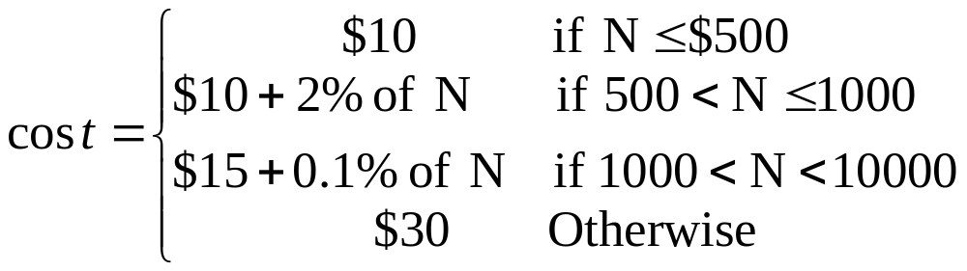
Charge for money transfer
Suppose you transfer $N and bank’s charge occurs as follows.
Write a program that reads N and computes cost

Slide 43
Spell out a number in text using if-else and switch
Write a program that reads a number between 1 and 999 from user and spells out it in English.
For example:
453 → Four hundred fifty three
37 → Thirty seven
204 → Two hundred four

Slide 44
Loop (Repetition) Structures

Slide 45
Problem: Conversion table degrees → radians
Degrees to Radians
0 0.000000
10 0.174533
20 0.349066
30 0.523599
…
340 5.934120
350 6.108653
360 6.283186
radians = degrees * PI / 180;

Slide 46
Sequential Solution
#include <stdio.h>
#define PI 3.141593
int main(void)
{
int degrees=0;
double radians;
printf("Degrees to Radians \n");
degrees = 0;
radians = degrees*PI/180;
printf("%d %f \n", degrees, radians);
degrees = 10;
radians = degrees*PI/180;
printf(“%d %f \n", degrees, radians);
degrees = 20;
radians = degrees*PI/180;
printf(“%d %f \n", degrees, radians);
…
degrees = 360;
radians = degrees*PI/180;
printf(“%d %f \n", degrees, radians);
}
degrees = ???
radians = degrees*PI/180;
printf("%d %f \n", degrees, radians);
Not a good solution

Slide 47
Loop Solution
#include <stdio.h>
#define PI 3.141593
int main(void)
{
int degrees=0;
double radians;
printf("Degrees to Radians \n");
while (degrees <= 360) {
radians = degrees*PI/180;
printf(“%d %f \n", degrees, radians);
degrees += 10;
}
}
degrees = ???
radians = degrees*PI/180;
printf("%d %f \n", degrees, radians);

Slide 48
Loop (Repetition) Structures
while statement
do while statement
for statement
Two new statements used with loops
  break and continue

Slide 49
while statement
while(expression)
statement;
while(expression) {
statement;
statement;
.
}

Slide 50
The while Control Structure
Example:
x = 1; i = 2;
while (i <= 9) {
x = x * i;
i = i + 1;
}
true
i <= 9
x = x * i; i = i + 1;
false

Slide 51
Example
#include <stdio.h>
#define PI 3.141593
int main(void)
{
int degrees=0;
double radians;
printf("Degrees to Radians \n");
while (degrees <= 360)
{
radians = degrees*PI/180;
printf("%6i %9.6f \n", degrees, radians);
degrees += 10;
}
return 0;
}

Slide 52
do while
do
statement;
while(expression);
do {
statement1;
statement2;
.
} while(expression);
note - the expression is tested after the statement(s) are executed, so statements are executed at least once.

Slide 53
4.8 The do…while Repetition Statement
Flowchart of the do…while repetition statement
action(s)
true
condition
false

Slide 54
Example
#include <stdio.h>
#define PI 3.141593
int main(void)
{
int degrees=0;
double radians;
printf("Degrees to Radians \n");
do
{
radians = degrees*PI/180;
printf("%6i %9.6f \n",degrees,radians);
degrees += 10;
} while (degrees <= 360);
return 0;
}

Slide 55
for statement
for(initialization; test; increment or decrement)
statement;
for(initialization; test; increment or decrement)
{
statement;
statement;
.
}

Slide 56
Example
#include <stdio.h>
#define PI 3.141593
int main(void)
{
int degrees;
double radians;
printf("Degrees to Radians \n");
for (degrees=0; degrees<=360; degrees+=10)
{
radians = degrees*PI/180;
printf("%6i %9.6f \n", degrees, radians);
}
return 0;
}

Slide 57
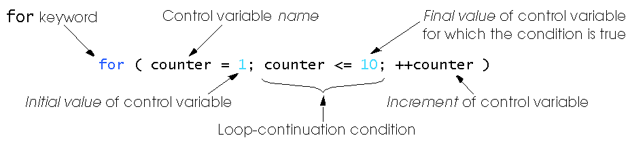
4.4 The for Repetition Statement

Slide 58
4.4 The for Repetition Statement
Format when using for loops
    for ( initialization; loopContinuationTest; increment )
    statement
Example:
    for(counter = 1; counter <= 10; counter++ )
    printf( "%d\n", counter );
  Prints the integers from one to ten
No semicolon (;) after last expression

Slide 59
Flow Chart of the Example for Loop
Establish
initial
value
of control
variable
counter = 1
counter = 1
counter <= 10
true
printf( "%d", counter );
counter++
Increment
Determine if
final
the control
false
Body of loop
variable
value
of control
(this may be many
variable has been
statements)
reached

Slide 60
The for Repetition Statement
For loops can usually be rewritten as while loops:
    initialization;
    while ( loopContinuationTest ) {
    statement;
    increment;
    }
Initialization and increment
  Can be more than one, comma-separated lists of statements
  Can even add the counter variable declaration in initialization
  Example:
    for (int i = 0, j = 0; j + i <= 10; j++, i++)
    printf( "%d\n", j + i );

Slide 61
Examples
int sum =0;
for( int i=1 ; i < 7 ; i+=2 )
sum = sum + i;
int fact =1;
for(int n=5;n>1;n--)
fact = fact * n;
?
0
5
1
3
1
5
7
i
sum
n
fact
1
4
9

Slide 62
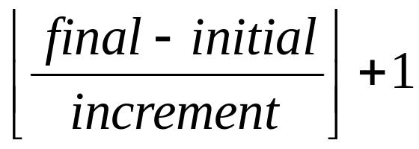
Exercise
Determine the number of times that each of the following for loops are executed.
for (k=3; k<=10; k++) {
statements;
}
for (k=3; k<=10; ++k) {
statements;
}
for(count=-2;count<=5; count++) {
statements;
}

Slide 63
Example
What will be the output of the following program, also show how values of variables change in the memory.
int sum1, sum2, k;
sum1 = 0;
sum2 = 0;
for( k = 1; k < 5; k++) {
if( k % 2 == 0)
sum1 =sum1 + k;
else
sum2 = sum2 + k;
}
printf(“sum1 is %d\n”, sum1);
printf(“sum2 is %d\n”, sum2);
0 2 6
0 1 4
1 2 3 4 5
sum1
sum2
k
sum1 is 6
sum2 is 4

Slide 64
break statement
break;
  terminates loop
  execution continues with the first statement following the loop
  sum = 0;
  for (k=1; k<=5; k++) {
  scanf(“%lf”,&x);
  if (x > 10.0)
  break;
  sum +=x;
  }
  printf(“Sum = %f \n”,sum);

Slide 65
continue statement
continue;
  forces next iteration of the loop, skipping any remaining statements in the loop
  sum = 0;
  for (k=1; k<=5; k++) {
  scanf(“%lf”,&x);
  if (x > 10.0)
  continue;
  sum +=x;
  }
  printf(“Sum = %f \n”,sum);

Slide 66
Example: A man walks
Suppose a man (say, A) stands at (0, 0) and waits for user to give him the direction and distance to go.
User may enter N E W S for north, east, west, south, and any value for distance.
When user enters 0 as direction, stop and print out the location where the man stopped
N
W
E
S

Slide 67
float x=0, y=0;
char direction;
float mile;
while (1) {
printf("Please input the direction as N,S,E,W (0 to exit): ");
scanf("%c", &direction); fflush(stdin);
if (direction=='0'){ /*stop input, get out of the loop */
break;
}
if (direction!='N' && direction!='S' && direction!='E' && direction!='W') {
printf("Invalid direction, re-enter \n");
continue;
}
printf("Please input the mile in %c direction: ", direction);
scanf ("%f",&mile); fflush(stdin);
if (direction == 'N'){ /*in north, compute the y*/
y+=mile;
} else if (direction == 'E'){ /*in east, compute the x*/
x+=mile;
} else if (direction == 'W'){ /*in west, compute the x*/
x-=mile;
} else if (direction == 'S'){ /*in south, compute the y*/
y-=mile;
}
}
printf("\nCurrent position of A: (%4.2f,%4.2f)\n",x,y); /* output A's location */

Slide 68
Example: what will be the output
int main()
{
int a, b, c;
a=5;
while(a > 2) {
for (b = a ; b < 2 * a ; b++ ) {
c = a + b;
if (c < 8) continue;
if (c > 11) break;
printf( “a = %d b = %d c = %d \n”, a, b, c);
} /* end of for-loop */
a--;
} /* end of while loop */
}
a = 5 b = 5 c = 10
a = 5 b = 6 c = 11
a = 4 b = 4 c = 8
a = 4 b = 5 c = 9
a = 4 b = 6 c = 10
a = 4 b = 7 c = 11
a = 3 b = 5 c = 8

Slide 69
More loop examples

Slide 70
Exercise
What is the output of the following program?
  for (i=1; i<=5; i++) {
  for (j=1; j<=4; j++){
  printf(“*”);
  }
  printf(“\n”);
  }
Output
****
****
****
****
****

Slide 71
Exercise
What is the output of the following program?
  for (i=1; i<=5; i++) {
  for (j=1; j<=i; j++){
  printf(“*”);
  }
  printf(“\n”);
  }
Output
*
**
***
****
*****

Slide 72
Example: nested loops to generate the following output
  i=1 *
  i=2 + +
  i=3 * * *
  i=4 + + + +
  i=5 * * * * *
int i, j;
for(i=1; i <= 5; i++){
printf("i=%d ", i);
for(j=1; j <= i; j++) {
if (i % 2 == 0)
printf("+ ");
else
printf("* ");
}
printf("\n");
}

Slide 73
Exercise: Modify the following program to produce the output.
  for (i=A; i<=B; i++) {
  for (j=C; j<=D; j++) {
  printf(“*”);
  }
  printf(“\n”);
  }
Output
*****
****
***
**
*

Slide 74
Exercise
Write a program using loop statements to produce the output.
Output
*
**
***
****
*****

Slide 75
For vs. while loop
Convert the following for loop to while loop
for( i=5; i<10; i++) {
pritntf(“ i = %d \n”, i);
}
i=5;
while(i<10){
pritntf(“ i = %d \n”, i);
i++;
}

Slide 76
For vs. while loop : Convert the following for loop to while loop
for( i=5; i<10; i++) {
printf(“AAA %d \n”, i);
if (i % 2==0) continue;
pritntf(“BBB %d \n”, i);
}
i=5;
while(i<10) {
printf(“AAA %d \n”, i);
if (i % 2==0) {
i++;
continue;
}
pritntf(“BBB %d \n”, i);
i++;
}

Slide 77
Compute x^{y} when y is integer
Suppose we don’t have pow(x,y) and y is integer, write a loop to compute x^{y}
Enter x, y
res=1;
for(i=1; i<=y; i++){
res = res * x;
}

Slide 78
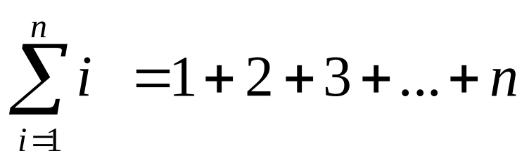

Exercise: sum
Write a program to compute the following
Enter n
total=0;
for(i=1; i<=n; i++)
total = total + i ;
print total
Enter n
total=0;
for(i=1; i<=n; i++)
total = total + 2 * i ;
print total

Slide 79
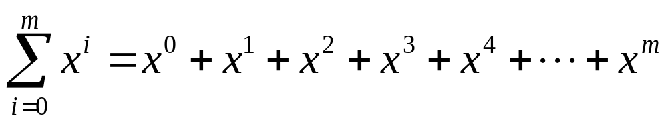
Exercise: sum
Write a program to compute the following
Enter x and m
total=0; sofarx=1;
for(i=0; i<=m; i++) {
total = total +sofarx;
sofarx = sofarx * x;
}
print total
Enter x and m
total=0;
for(i=0; i<=m; i++)
total = total + pow(x, i);
print total

Slide 80
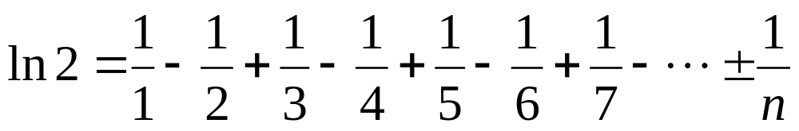
Exercise: ln 2
Write a program to compute the following
Enter n
ln2=0;
for(i=1; i<=n; i++)
if ( i % 2 == 0)
ln2 = ln2 - 1.0 / i;
else
ln2 = ln2 + 1.0 / i;
print total

Slide 81
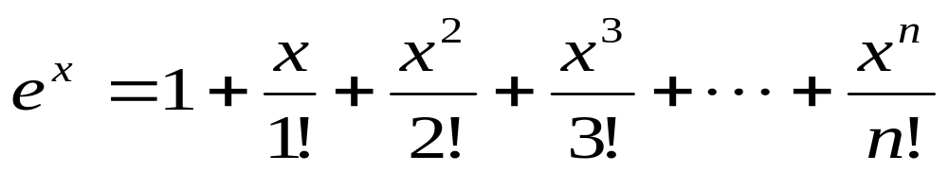
Exercise: e^{x}
Write C program that reads the value of x and n from the keyboard and then approximately computes the value of using the following formula:
Then compare your approximate result to the one returned by exp(x) in C library, and print out whether your approximation is higher or lower.

Slide 82
int i, n;
double x, ex;
double powx, fact;
printf("Enter the value of x and n : ");
scanf("%lf %d",&x, &n);
/* Write a loop to compute e^x using the above formula */
ex=1.0; fact=1.0; powx=1.0;
for(i=1; i<=n; i++){
powx = powx * x;
fact = fact * i;
ex = ex + powx / fact;
}
printf("Approx value of e^x is %lf when n=%d\n",ex, n);
/* Check if ex is higher/lower than exp(x) in math lib.*/
if(ex < exp(x))
printf("ex est is lower than exp(x)=%lf\n",exp(x));
else if (ex > exp(x))
printf("ex est is higher than exp(x)=%lf\n",exp(x));
else
printf("ex est is the same as exp(x)\n");

Slide 83
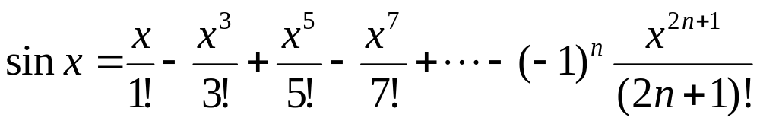
Exercise: sin x
Compute sin x using
Get n
total=0; powx=x; factx=1;
for(i=0; i <= n; i++){
k= 2*n+1;
if (i%2==0) total= total - powx/factx;
else total= total + powx/factx;
powx= powx * x * x;
factx = factx * k * (k-1);
}
Print total;

Slide 84
Example
Write a program that prints in two columns n even numbers starting from 2, and a running sum of those values. For example suppose user enters 5 for n, then the program should generate the following table:
Enter n (the number of even numbers): 5
Value Sum
2 2
4 6
6 12
8 20
10 30

Slide 85
#include <stdio.h>
int main(void)
{
/* Declare variables. */
int n;
int sum, i;
printf("Enter n ");
scanf("%d",&n);
printf("Value \t Sum\n");
sum = 0;
for(i=1; i <=n; i++){
sum = sum + 2*i;
printf("%d \t %d\n", 2*i, sum);
}
return 0;
}

